Slide 1
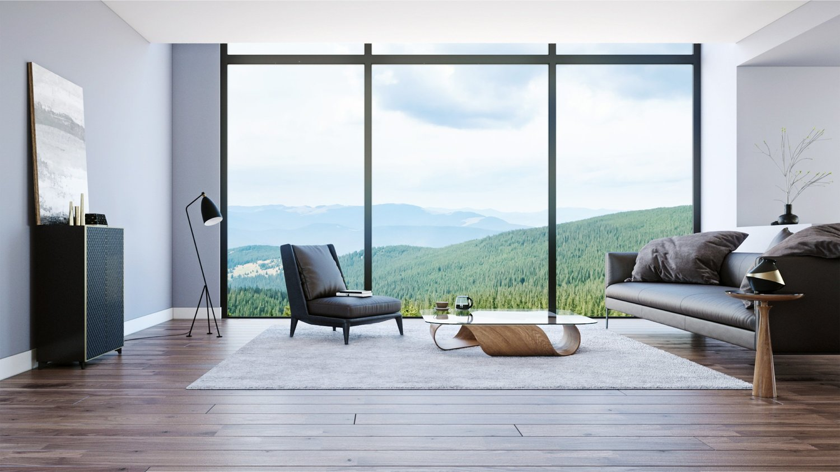
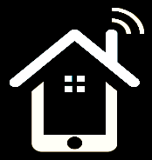
RentRaction Professionally Managed homes

Slide 2

An effective way of Interaction among Property Owners and Renters.

Slide 3

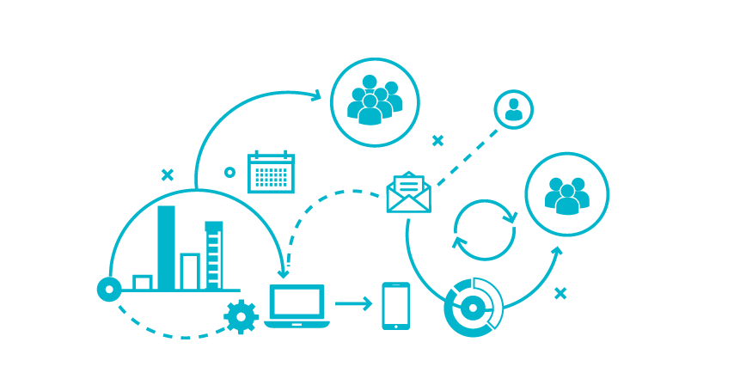
Problem Definition
To overcome the problem of difficulties faced by tenants, owners and property managers while communicating with each other, a more cozy way of organized and meaningful interaction through a web application has been proposed.

Slide 4


Some Mandatory Facts
Around 32.2% of Canadian households are rented homes which is around 4.6 million of the total 14.1 million households.
Around half a million of them are students which is a 20% increase from 2016.
90% of the international students prefer off campus residency which means there are high chances of increase in the number of people who are going to rent a home.

Slide 5


Slide 6
Some More Facts
The federal government is aiming to bring a total of 310,000 newcomers to Canada in 2018
By 2020, the yearly total will hit 340,000.

Slide 7


Slide 8


Target Customers
Property Owners
Chat with tenants, managers
Respond to Tenants’ maintenance requests
View new applications for their houses
Renters/Tenants
Apply for renting a house
Chat with the owner
Request for maintenance through the application
Pay rent online
Property Managers
Freelancers who Get a maintenance task assigned from the owners
Work on the request and resolve the maintenance request.

Slide 9

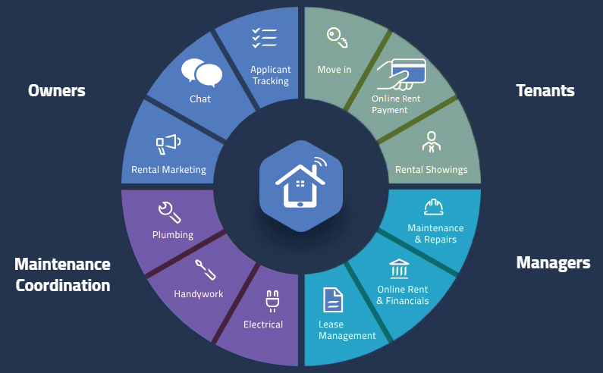
A Simple Overview

Slide 10


Implementation
A web application with MySQL as database has been developed
With individual registration and login system for each of owner, tenant and managers.
Each kind of user have their own dashboard to manage stuffs and a system to interact with.

Slide 11




The Chat System
Owner
Tenants under him/her
Manager
Respective
owner and tenants

Slide 12

Marketing System
Proud owners can advertise their rentals.
Tenants can see all the available properties and apply for renting them.

Slide 13

Payment System
The tenants can pay their owners online though an online payment portal within the application
The owners can notify their tenants if the payment is due
The owners will get notified once the payment is made by their tenants

Slide 14


Maintenance System
A maintenance request can be made online by the tenants if they face any problems at their home.
Either the owner can respond to it or it will be assigned to any manager.
The manager will work on the request and resolve the issue

Slide 15
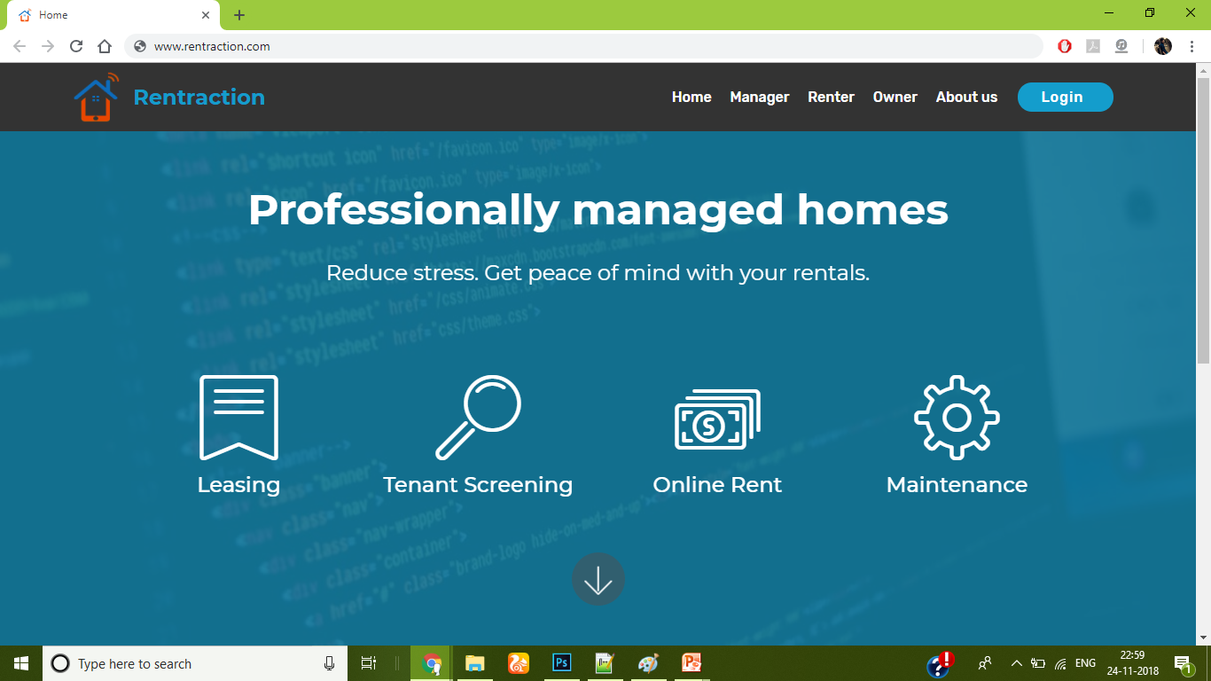
Home of Homes
The home screen of the web application
Place your screenshot here

Slide 16
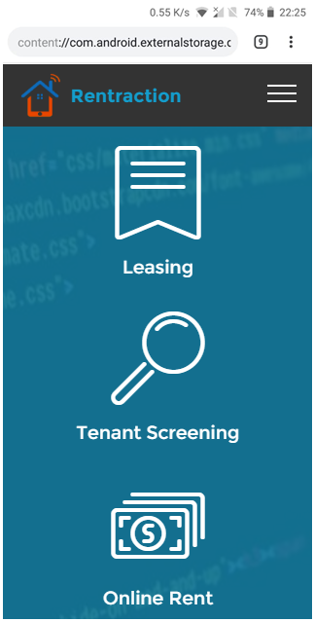
Mobile Friendly
Place your screenshot here
The application is responsive and thus it is mobile and tablet friendly

Slide 17

Future Plans
To implement the Manager part more efficiently
To implement a ticketing system for maintenance requests
To implement the same application as a mobile app.

Slide 18


THANKS!
Any questions

Slide 19


References
Household data:
https://www.bnnbloomberg.ca/census-home-ownership-rates-take-historic-dip-as-more-canadians-opt-to-rent-1.895239
Student data:
https://www.canadastudynews.com/2018/03/19/canada-is-home-to-nearly-half-a-million-international-students/
Canadian Immigration data:
https://globalnews.ca/news/3836805/340k-immigrants-per-year-by-2020-government-unveils-new-immigration-targets/

